Slide 1
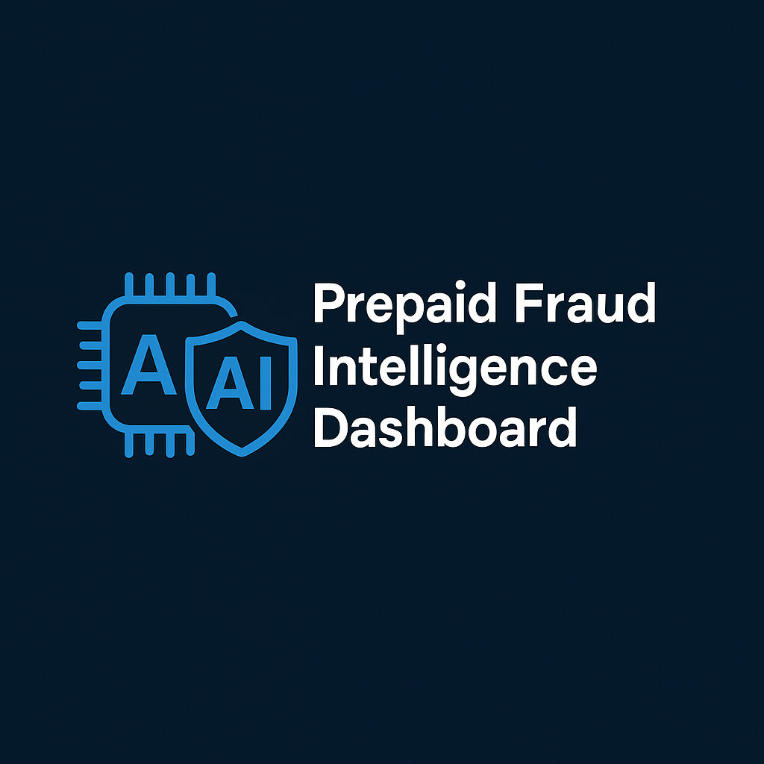
Prepaid Fraud Intelligence Dashboard
Revolutionizing Fraud Detection with Generative AI
Presented to: EPS Team (Enterprise Prepaid System)
Presented by: Suresh Paulraj, AI Powered Solutions Architect

Slide 2
The Challenge: The Modern Fraud Landscape
Increasing Sophistication: Fraudsters are using advanced techniques, from automated bots to social engineering, making manual detection difficult.
Volume & Velocity: The sheer volume of daily transactions makes it impossible for human analysts to monitor everything in real-time.
Hidden Patterns: Complex fraud rings and coordinated attacks often hide within massive datasets, their patterns invisible to traditional rule-based systems.
Analyst Fatigue: Constant high-stakes monitoring leads to burnout and a higher chance of human error.
My solution leverages Generative and Agentic AI to meet these challenges head-on.

Slide 3
The Solution: A Centralized Intelligence Hub
The Prepaid Fraud Intelligence Dashboard provides a single pane of glass for monitoring, investigating, and resolving fraud in real-time. It transforms raw data into actionable intelligence.
Key Pillars:
Real-time Visibility: At-a-glance overview of the current fraud landscape.
AI-Powered Insights: Proactive identification of threats and focus areas.
Intelligent Investigation Tools: Streamlining the process from detection to resolution.
Automated Actions: Empowering analysts with agentic AI workflows.

Slide 4
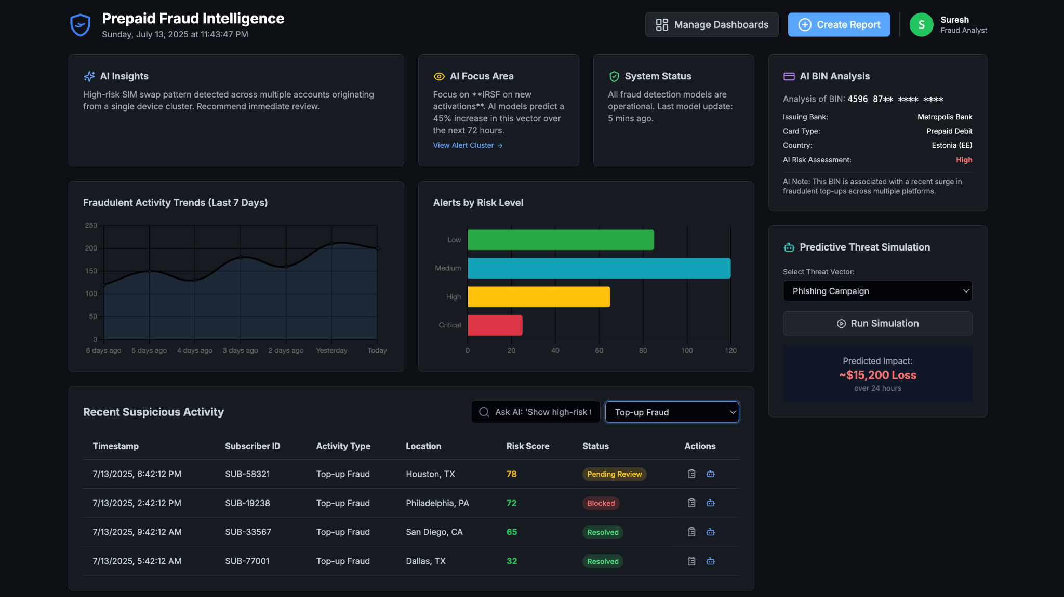

Slide 5
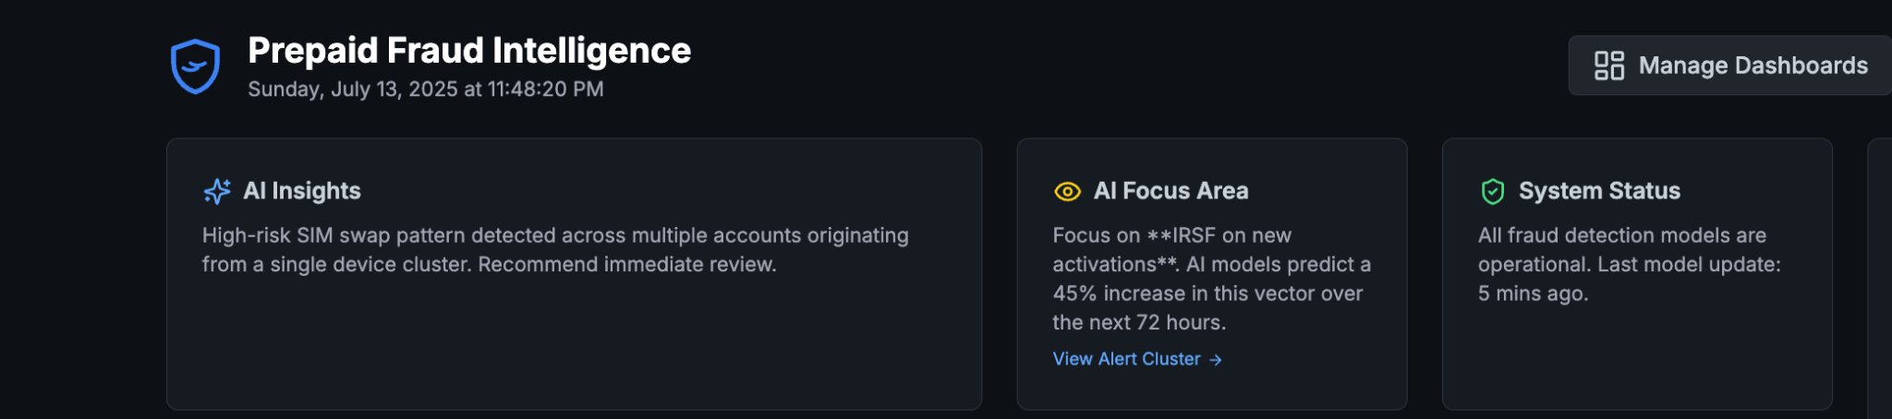
Feature Deep Dive: AI Insights & Focus Area
This is not just data visualization; this is data interpretation. The top-level cards provide immediate, high-value intelligence.

Slide 6
Feature Deep Dive: AI Insights & Focus Area
Gen AI Capabilities:
Natural Language Generation (NLG): The "AI Insights" card uses Gen AI to synthesize complex events from multiple data streams into a simple, human-readable sentence. It analyzes alerts, trends, and system status to generate a concise, actionable summary.
Predictive Analytics: The "AI Focus Area" leverages machine learning models to forecast emerging threats. It analyzes subtle shifts in global and domestic fraud patterns to predict which vector (e.g., IRSF, SIM Swap) will see an increase, allowing the team to proactively adjust their strategy.
Automated Filtering: The "View Alert Cluster" link is an example of AI-driven workflow integration. It understands the context ("IRSF") and automatically applies the correct filters to the activity table, saving the analyst valuable time.

Slide 7
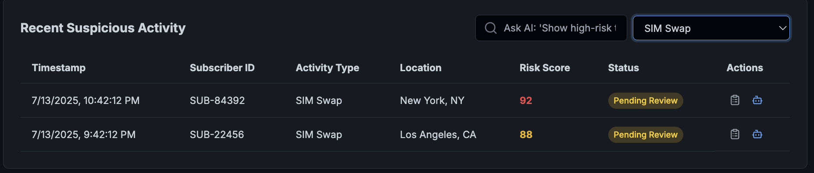
Feature Deep Dive: The "Ask AI" Smart Search
We've moved beyond simple keyword search. The "Ask AI" feature allows analysts to query the data using natural language, just like talking to a colleague.

Slide 8
Feature Deep Dive: The "Ask AI" Smart Search
Gen AI Capabilities:
Natural Language Understanding (NLU): The search bar is powered by an NLU model that can parse complex queries. It understands intent, entities (like "sim swap"), modifiers (like "high-risk"), and locations ("California").
Semantic Search: Instead of just matching keywords, the AI understands the meaning behind the query. A search for "high risk" correctly translates to risk score >= 80, and it can combine multiple conditions seamlessly.
Dynamic Filtering: The AI translates the natural language query into structured filters that are instantly applied to the data grid, providing immediate, relevant results without complex query building.

Slide 9
Feature Deep Dive: The AI Assistant
For every suspicious activity, the AI Assistant acts as a co-pilot for the fraud analyst, providing context and tools for rapid decision-making.
Gen AI Capabilities:
Dynamic Content Generation: The "Recommended Actions" and "Risk Explanation" are not static. The AI generates unique, context-specific content for each alert based on its type. A SIM Swap alert will have different recommendations and explanations than a Top-up Fraud alert.
Explainable AI (XAI): The "Explain the Risk" feature is a core component of XAI. It deconstructs the complex model's decision (the risk score) into understandable factors (e.g., Location Anomaly, Device Linkage), building analyst trust and transparency in our AI systems.

Slide 10
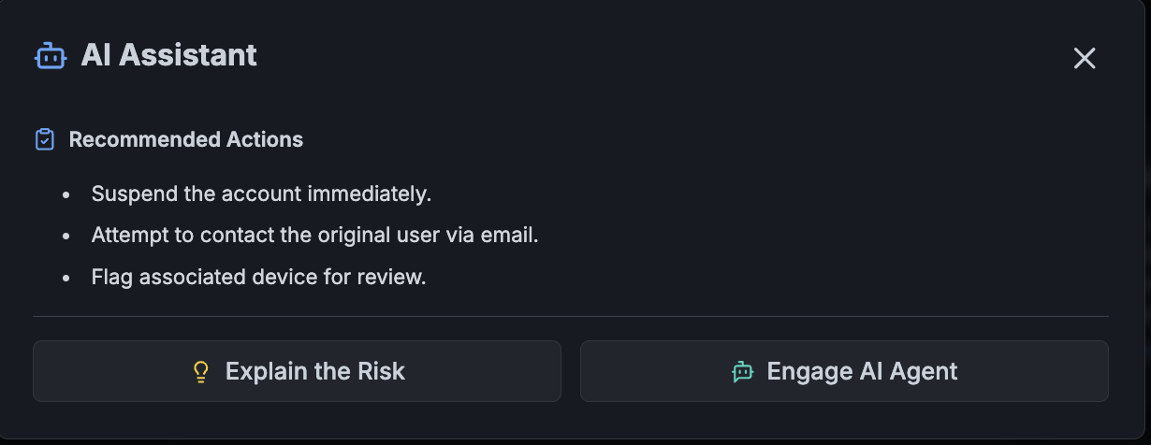
Feature Deep Dive: The AI Assistant

Slide 11
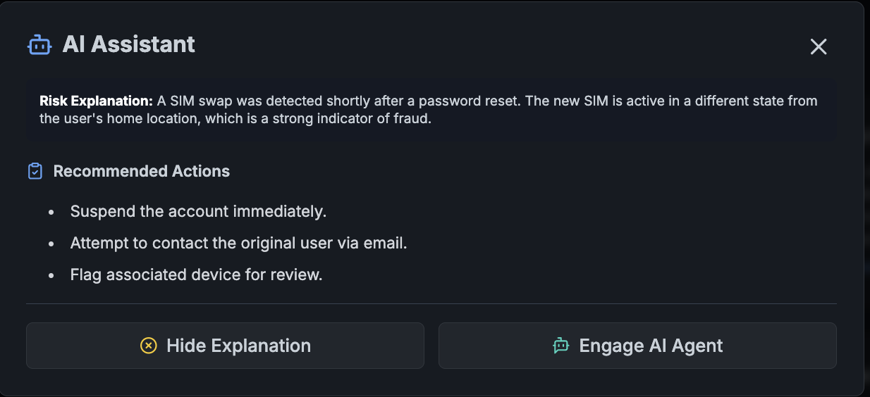
Feature Deep Dive: The AI Assistant

Slide 12
The Power of Agentic AI: Automated Resolution
This is where the dashboard transcends monitoring and becomes an active participant in fraud resolution. The "Engage AI Agent" feature kicks off an autonomous workflow.
Gen AI & Agentic Capabilities:
Planning & Reasoning: The agent demonstrates a "chain of thought." It first forms a plan (Initiating investigation...), then executes a series of logical steps to gather evidence.
Tool Use (Simulated): The agent autonomously interacts with other systems. It "queries" mock MCP servers for subscriber data and network history, simulating real-world API calls to our internal platforms.
Autonomous Action: Based on the data it gathers, the agent makes a decision and takes action. It sends commands to suspend the user and block the device, demonstrating a complete, end-to-end resolution for clear-cut cases.
Transparency: The entire process is logged in a clear, step-by-step format, providing a full audit trail of the agent's actions for compliance and review.

Slide 13
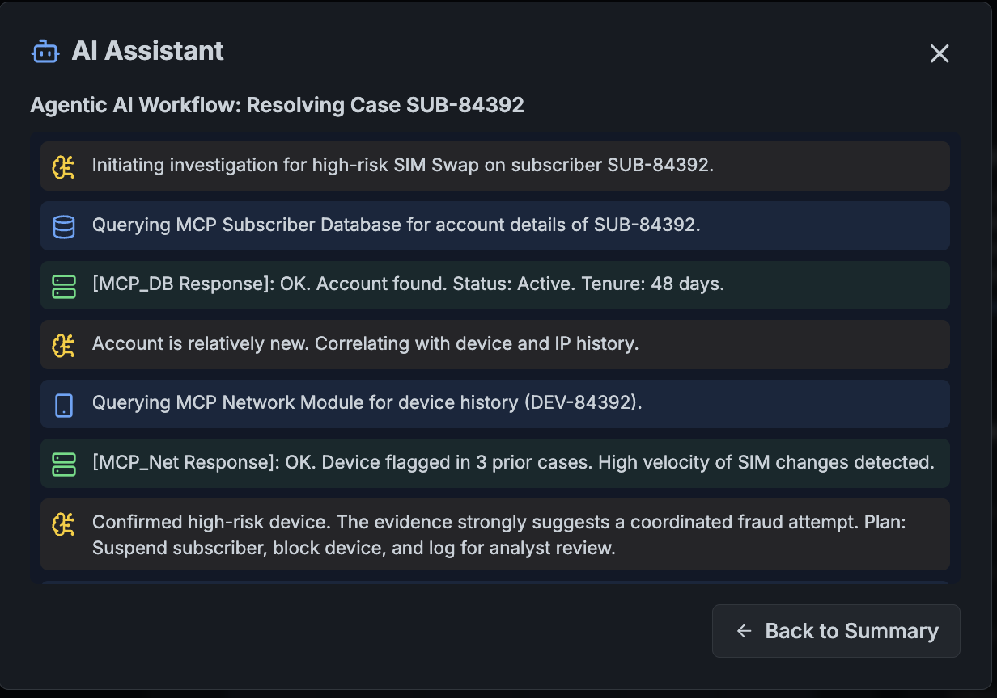

Slide 14
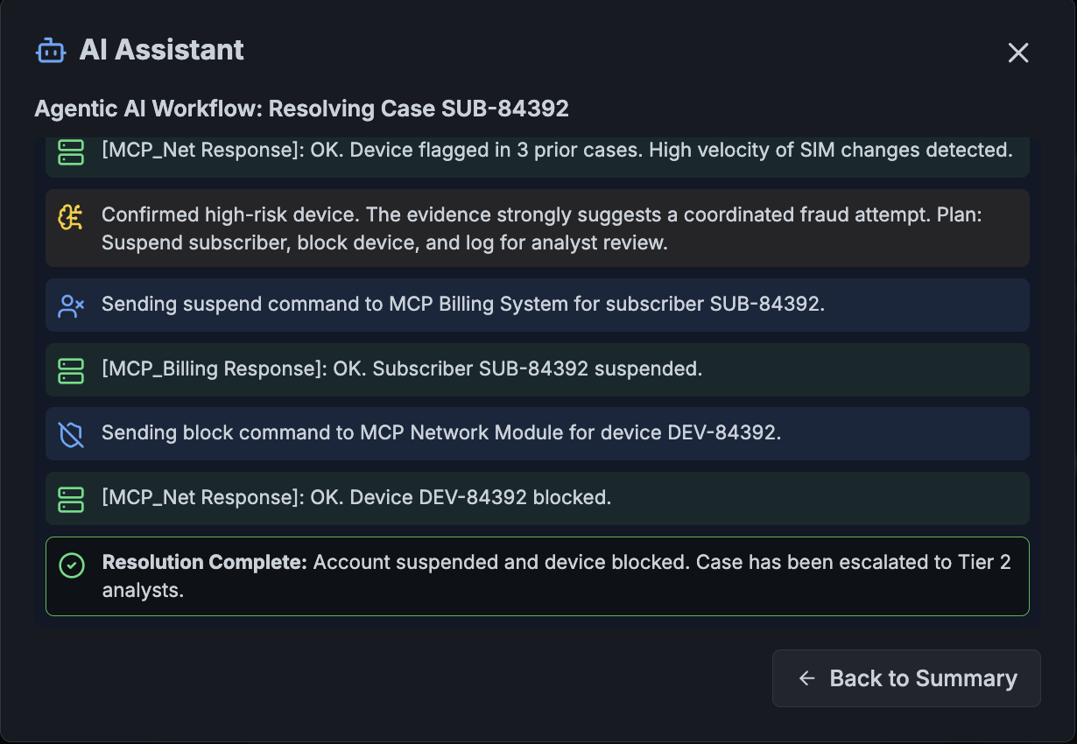

Slide 15
Proactive Defense: Predictive Simulation & Reporting
The dashboard empowers analysts to move from a reactive to a proactive stance against fraud.
Gen AI Capabilities:
Predictive Modeling: The "Predictive Threat Simulation" uses ML models to forecast the potential financial impact of various large-scale fraud scenarios. This allows us to run "what-if" analyses to better prepare for emerging threats.
Automated Report Generation: The "Create Report" feature uses Gen AI to dynamically compile data from the filtered view into a professional, downloadable PDF. It automatically formats the data, adds titles and timestamps, and creates a clean, shareable artifact for management or archival purposes in seconds.

Slide 16
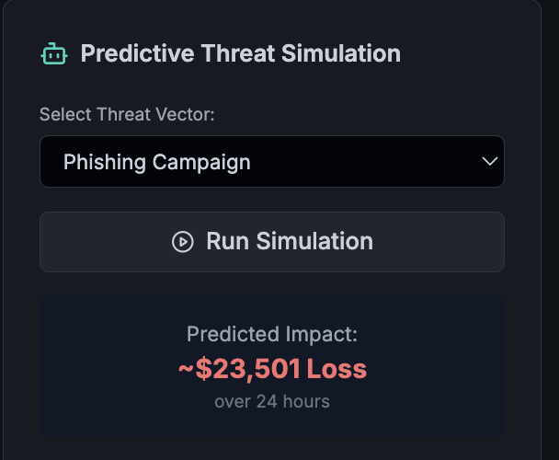

Slide 17
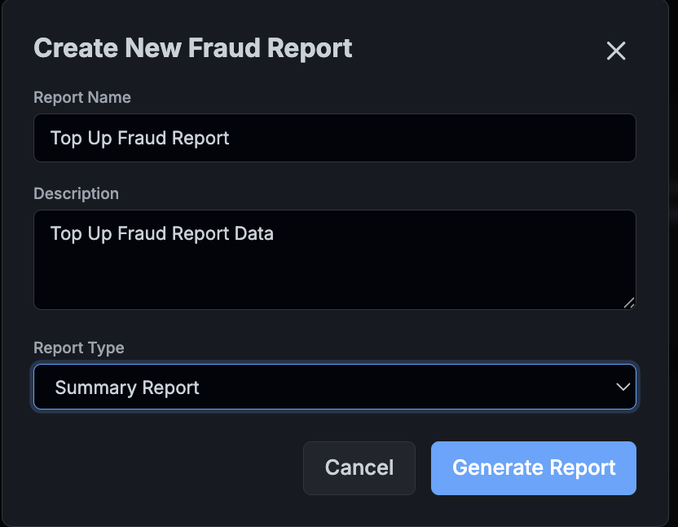

Slide 18
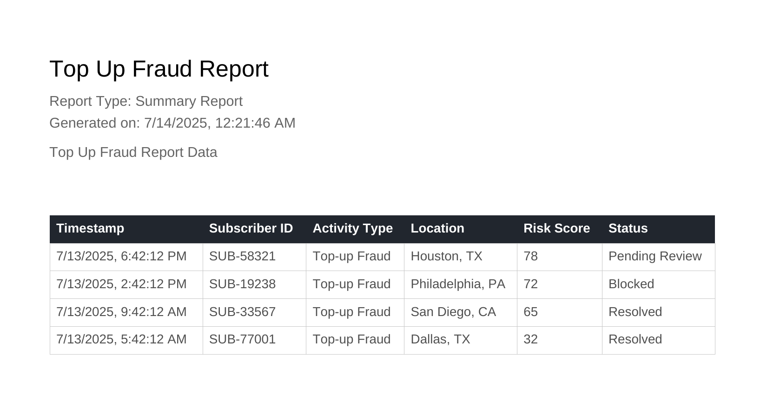

Slide 19
Summary & Benefits
The Prepaid Fraud Intelligence Dashboard is more than a tool; it's a strategic asset.
Increased Efficiency: Automates routine tasks, allowing analysts to focus on high-value investigations.
Enhanced Accuracy: AI models detect complex patterns that are invisible to the human eye, reducing false positives and catching more fraud.
Proactive Stance: Moves the team from reacting to fraud to predicting and preventing it.
Empowered Analysts: Provides intuitive, powerful tools like "Ask AI" and the "AI Agent" that augment the analyst's own expertise.
Reduced Revenue Loss: By enabling faster detection and automated resolution, the dashboard directly protects the bottom line.

